Slide 1
Mechanisms for supersmarticle boundary

Slide 2
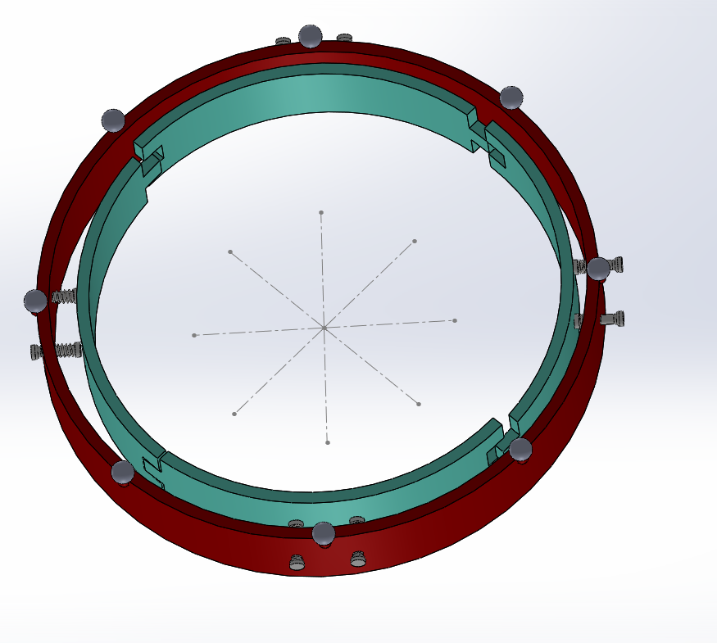
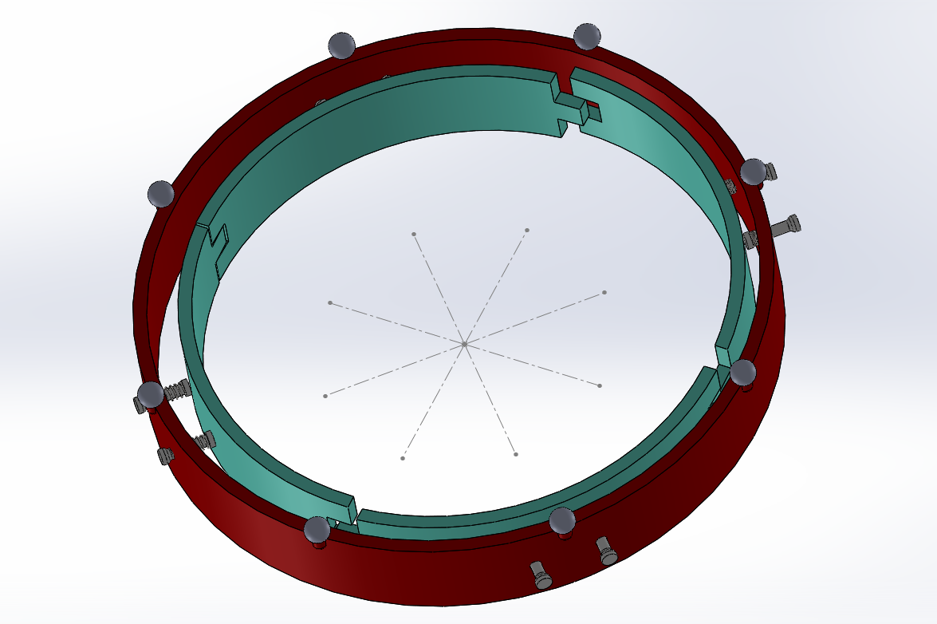

Slide 3
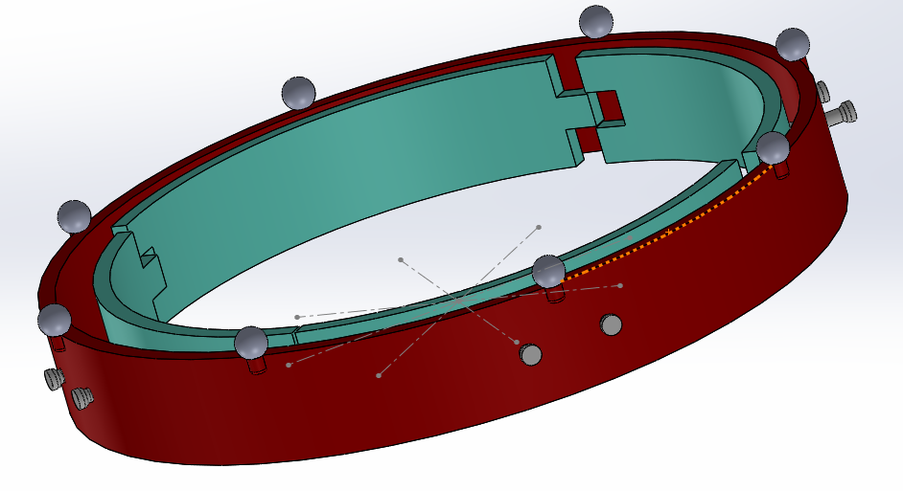

Slide 4
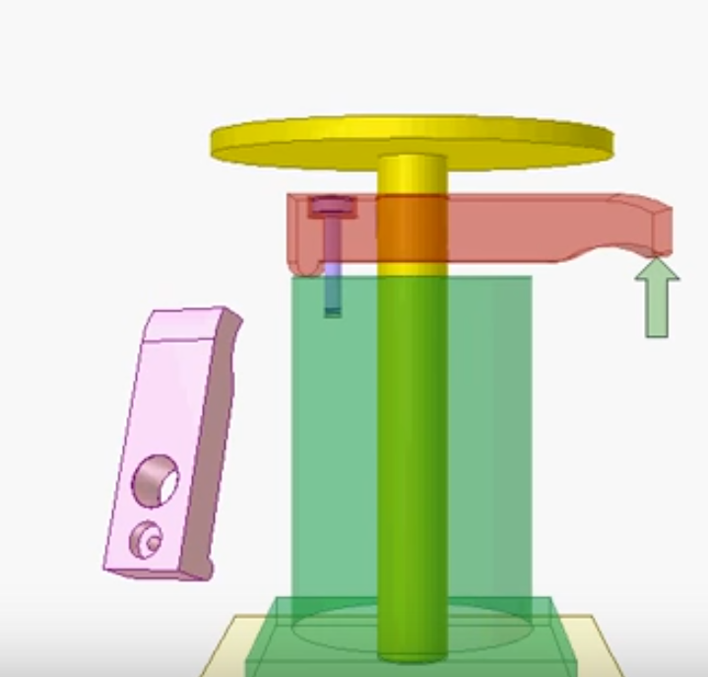
Table clamp
http://www.mechanisms.co/jigs-and-fixtures/table-clamp/

Slide 5
Dc motor rotates cam

Slide 6
Capacitor to power DC motor
RC circuit discharge
U
V
Add bumps to create a high walled potential well
x
Entrance
bump
Exit
bump
t
Only small range can supply enough voltage to overcome friction to rotate cam into position

Slide 7
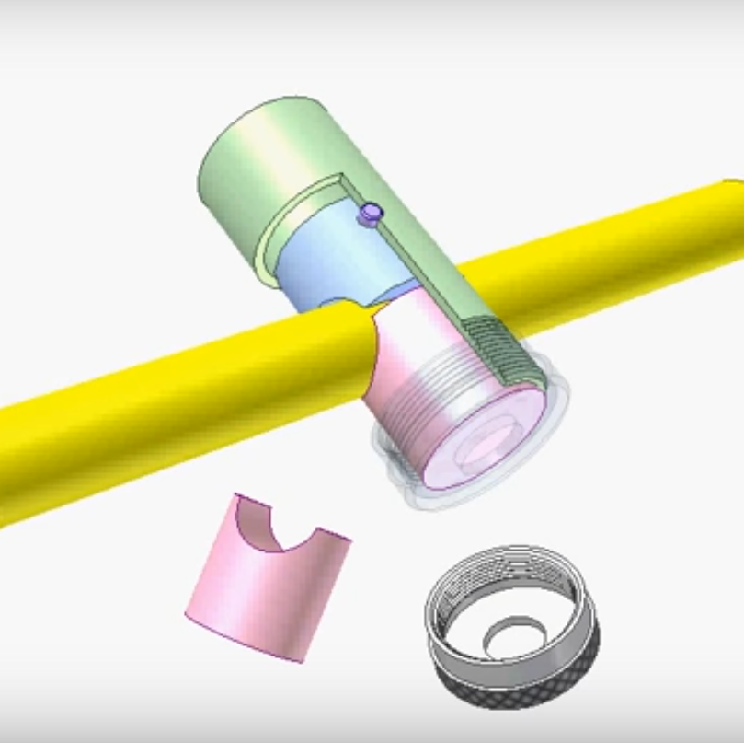
Fastener
http://www.mechanisms.co/jigs-and-fixtures/fastener-2/

